Slide 1

COMP90050: Advanced Database Systems
Lecturer: Farhana Choudhury (PhD)
Backups
Week 12 part 1

Slide 2
Core Concepts of Database management system
Efficiency
- Disks and I/O bandwidth
- Main memory
- Type of architecture
Database performance metrics
Hardware
Software/ DB tuning
- Types of DB
- Indexing
- Query optimisation
Efficiency/speed
Effectiveness
Effectiveness
Concurrent users
Users reading and writing over the same data
Security & Reliability
Transactions
Required tasks are all done together
Reliability
Crash recovery
Fault tolerance
Data duplication

Slide 3
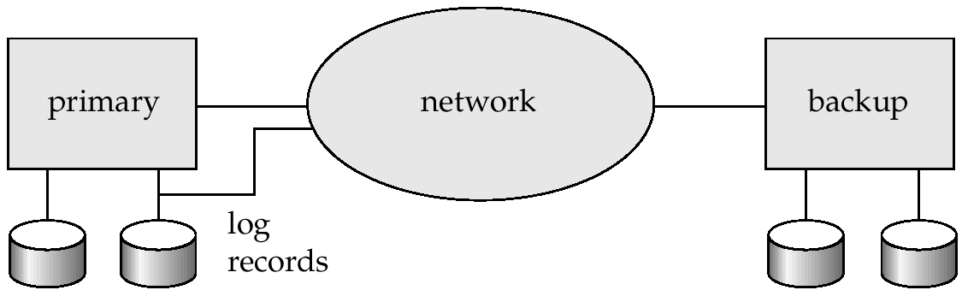
Other Considerations: Remote Backup Systems
Remote backup systems provide high availability by allowing transaction processing to continue even if the primary site is destroyed

Slide 4
Remote Backup Systems Contd.
Detection of failure: Backup site must detect when primary site has failed
To distinguish primary site failure from link failure, maintain several communication links between the primary and the remote backup
Use heart-beat messages
Transfer of control:
To take over control, backup site first perform recovery using its copy of the database and all the log records it has received from primary
Thus, completed transactions are redone and incomplete transactions are rolled back
When the backup site takes over processing it becomes the new primary

Slide 5
Remote Backup Systems Contd.
Time to recover:
To reduce delay in takeover, backup site periodically processes the redo log records
In effect, it performs a checkpoint, and can then delete earlier parts of the log
Hot-Spare configuration permits very fast takeover:
Backup continually processes redo log record as they arrive, applying the updates locally
When failure of the primary is detected the backup rolls back incomplete transactions, and is ready to process new transactions

Slide 6
Remote Backup Systems Contd.
To ensure durability of updates - delay transaction commit until update is logged at backup
But we can avoid this delay by permitting lower degrees of durability
One-safe: commit as soon as transaction’s commit log record is written at primary
Problem: updates may not arrive at backup before it takes over.
Two-very-safe: commit when transaction’s commit log record is written at primary and backup
Reduces availability since transactions cannot commit if either site fails.
Two-safe: proceed as in two-very-safe if both primary and backup are active. If only the primary is active, the transaction commits as soon as is commit log record is written at the primary
Better availability than two-very-safe; avoids problem of lost transactions in one-safe.

Slide 7
Alternative to Logs: Shadow Paging
Shadow paging is an alternative to log-based recovery
Idea: maintain two pageTables during the lifetime of a transaction –the current page table, and the shadow page table
Store the shadow page table in nonvolatile storage, such that state of the database prior to transaction execution may be recovered
Shadow page table is never modified during execution

Slide 8
Alternative to Logs: Shadow Paging
To start with, both the page tables are identical. Only the current page table is used for data item accesses during execution of the transaction
Whenever any page is about to be written:
A copy of this page is made onto an unused page
The current page table is then made to point to the copy
The update is performed on the copy

Slide 9
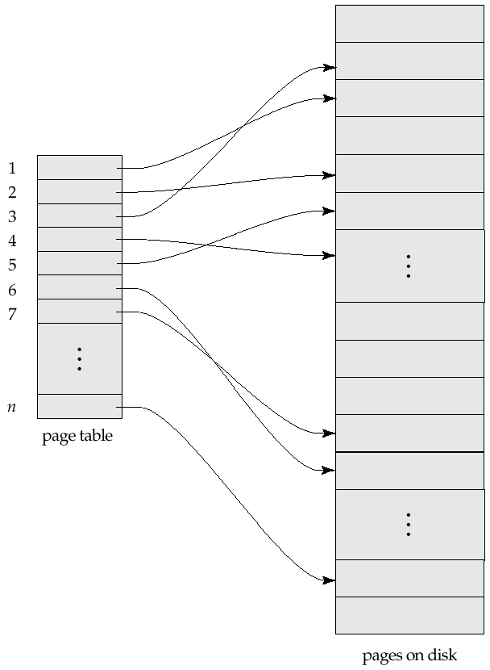
Sample Page Table

Slide 10
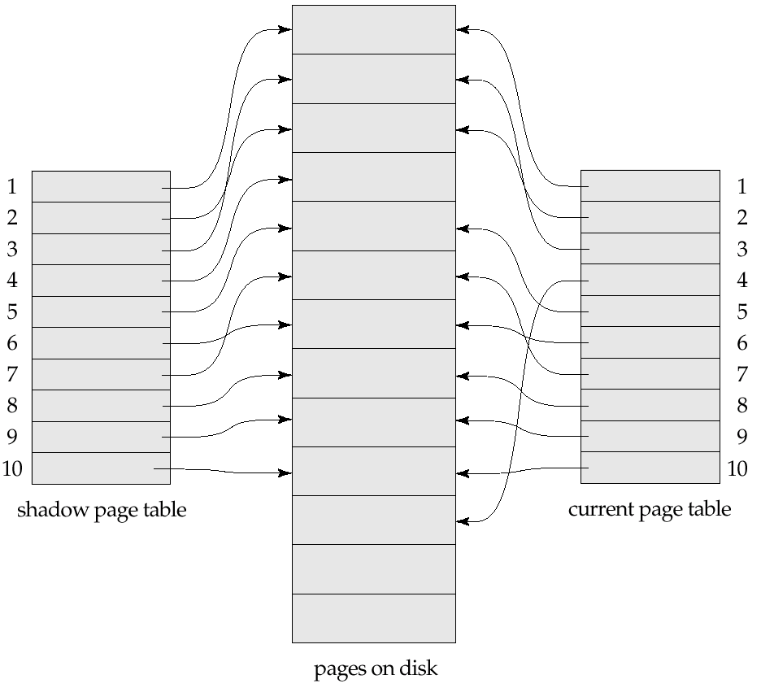

Example of Shadow Paging
Shadow and current page tables after write to page 4

Slide 11
Shadow Paging Contd.
To commit a transaction:
1. Flush all modified pages in main memory to disk
2. Output current page table to disk
3. Make the current page table the new shadow page table, as follows:
keep a pointer to the shadow page table at a fixed (known) location on disk.
to make the current page table the new shadow page table, simply update the pointer to point to current page table on disk.
Once pointer to shadow page table has been written, transaction is committed.

Slide 12
Shadow Paging Contd.
No recovery is needed after a crash — new transactions can start right away, using the shadow page table.
Advantages of shadow-paging over log-based schemes:
No overhead of writing log records
Recovery is trivial
Disadvantages:
Copying the entire page table is very expensive when the page table is large
Pages not pointed to from current/shadow page table should be freed (garbage collected)
Commit overhead is high - flush every updated page, and page table
Data gets fragmented (related pages get separated on disk)
Hard to extend algorithm to allow transactions to run concurrently

Slide 13
Backups and crash recovery in practice
Strategy plan based on:
Goals and requirement of your organization/task
The nature of your data and usage pattern
Constraint on resources
Design backup strategy:
Full disk backup vs partial - Are changes likely to occur in only a small part of the database or in a large part of the database?
How frequently data changes
If frequent: use differential backup that captures only the changes since the last full database backup
Space requirement of the backups – depends on the resource
Multiple past instances of backup – useful if point-in-time recovery is needed
Resource: https://learn.microsoft.com/en-us/sql/relational-databases/backup-restore
/back-up-and-restore-of-sql-server-databases?view=sql-server-ver16

